Slide 1
Design of Classifiers- Different approaches
Dr. Umarani Jayaraman 7th April 2022

Slide 2
Design of Classifier: Approaches
Approach 1:
Assumption: known probabilities
Parameters are known
Approach 2:
Assumption: known probabilities
Parameter Estimation: Parameter are unknown and try to estimate from samples
MLE and Bayesian Estimation methods
Approach 3:
No Assumption: No probability is assumed
Non-parameter Estimation:
Parzen Window: Estimation of density function P(x/ωi) using sample patterns
K-NN: Estimation of a posteriori probability P(ωi/x) directly based on sample patterns

Slide 3
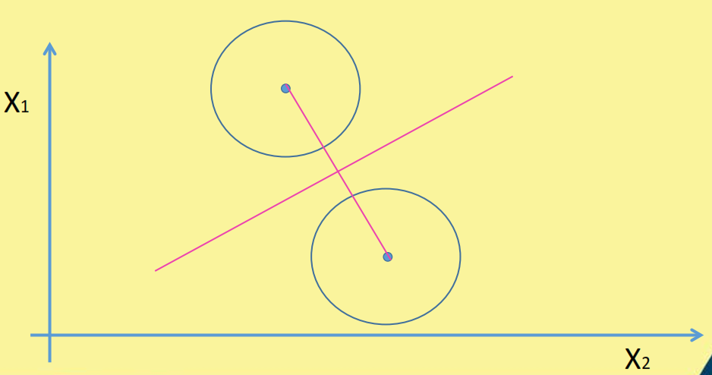
Approach 1 : known probabilities Minimum Distance Classifier
Case 1 of Bayes classifier
Euclidean Distance

Slide 4
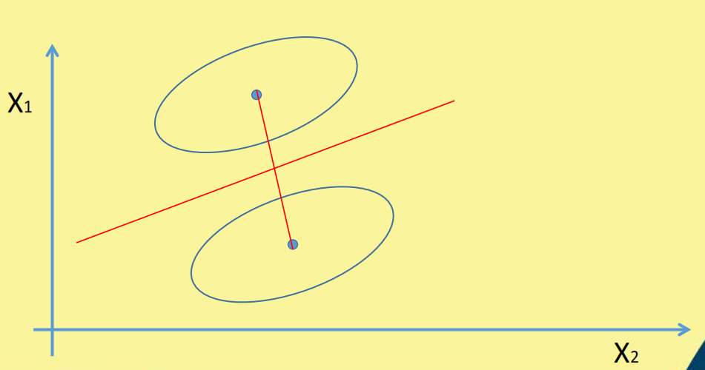
Approach 1 : known probabilities Minimum Distance Classifier
Case 2 of Bayes classifier
Mahalanobis Distance

Slide 5
Approach 1 : known probabilities
Bayes Classifier
In Bayes classifier, it is assumed that both prior probabilities and class-conditional densities are known.
But, in pattern recognition applications, we rarely have this kind of complete knowledge about the probabilities.

Slide 6
Approach 2 : Parameter Estimation
Parameter Estimation (Chapter 3)
It is also assumed that forms of the underlying density functions are known, but actual parameters are not known
One approach is to use the samples (class labels) to estimate the unknown probabilities and then use these estimates as if they are true values.
Suppose, for example, if we assume that class conditional density is a normal density with mean and covariance matrix
Now, the problem simplifies to estimating the parameters mean and covariance matrix

Slide 7
Approach 2 : Parameter Estimation
Parameter Estimation
Maximum Likelihood Estimation
Bayesian Estimation

Slide 8
Approach 3 : Nonparametric Technique
Nonparametric Technique:
There is no assumption about the probability
Without the assumption that the forms of the underlying densities are known (or) It is not assumed any forms of the densities
Non-parametric Methods
Parzen Window
k-NN rule
Linear Discriminant function (Linear classifiers)

Slide 9
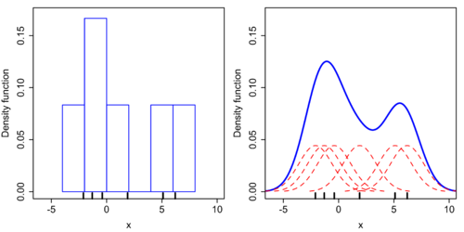
Approach 3 : Nonparametric Technique
Nonparametric Technique (Chapter 4)
Use samples to estimate the density functions P(x/ω_{i}) by the method called Parzen Windows
This is a kind of density Estimation

Slide 10
Approach 3 : Nonparametric Technique
Parzen Window:
Estimating the PDF p(x) based on a given set of training samples D= {x₁,x₂,x₃…,x_{n}}
Histograms are the simplest way to density estimation p(x) = n_{i}/v_{n}
where n_{i} is the number of training samples and v_{n} is the volume of the cell/ bin

Slide 11
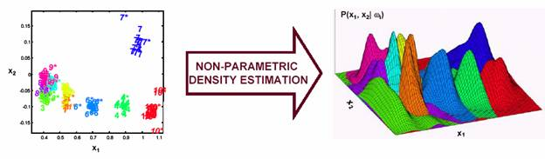
Approach 3 : Nonparametric Technique
Parzen Window:
But this method is not good for too many features

Slide 12
Approach 3 : Nonparametric Technique
Nonparametric Technique (Chapter 4)
K-NN search: Alternate approach
Another approach is directly estimating the a posteriori probabilities P(ω_{i} /x).
Nearest-neighbor rule, which bypass probability estimation and go directly to decision function (i.e) P(ω_{i} /x).

Slide 13
Approach 3 : Nonparametric Technique

Slide 14
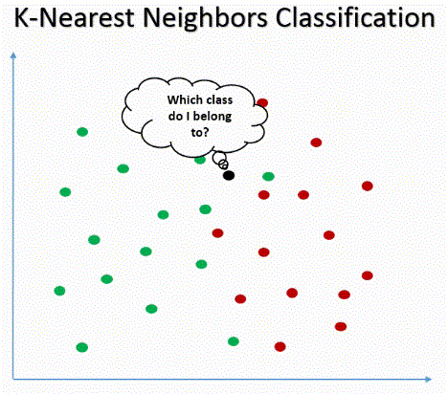
Approach 3 : Nonparametric Technique
K- Nearest Neighbor

Slide 15
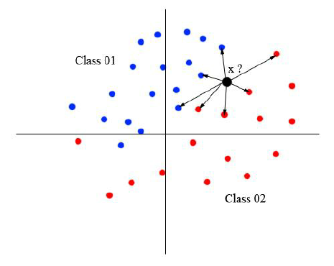
Approach 3 : Nonparametric Technique
Nearest Neighbor Search

Slide 16
Approach 3 : Nonparametric Technique based on discriminant function
Linear Discriminant Functions / Linear Classifiers (Chapter 5)

Slide 17
Source
https://jeremykun.com/2017/06/05/formulating-the-support-vector-machine-optimization-problem/

Slide 18
Thank you

Slide 19
